Slide 1
Super Image-Resolution using CNN
TEAM MEMBERS
Aditya S RA2011003010252
Varad Shinde RA2011003010259
Viraj Agarwal RA2011003010262

Slide 2
Abstract
We propose a deep learning method for single image super-resolution (SR).
Our method directly learns an end-to-end mapping between the low/high-resolution images.
The mapping is represented as a deep convolutional neural network (CNN) that takes the low-resolution image as the input and outputs the high-resolution one.
We further show that traditional sparse-coding-based SR methods can also be viewed as a deep convolutional network.
But unlike traditional methods that handle each component separately, our method jointly optimizes all layers.
Our deep CNN has a lightweight structure, yet demonstrates state-of-the-art restoration quality, and achieves fast speed for practical on-line usage.
We explore different network structures and parameter settings to achieve trade- offs between performance and speed.
Moreover, we extend our network to cope with three color channels simultaneously, and show better overall reconstruction quality.

Slide 3
INTRODUCTION
Single image super-resolution which aims at recovering a high-resolution image from a single low- resolution image, is a classical problem in computer vision.
This problem is inherently ill-posed since a mul- tiplicity of solutions exist for any given low-resolution pixel. In other words, it is an underdetermined in- verse problem, of which solution is not unique.
Such a problem is typically mitigated by constraining the solution space by strong prior information. To learn the prior, recent state-of-the-art methods mostly adopt the example-based [46] strategy.
sparse-coding-based method [49], [50] is one of the representative external example-based SR methods.
This method involves several steps in its solution pipeline.
First, overlapping patches are densely cropped from the input image and pre-processed.
These patches are then encoded by a low-resolution dictionary.
The sparse coefficients are passed into a high-resolution dictionary for reconstructing high-resolution patches.

Slide 4
INTRODUCTION
The overlapping constructed patches are aggregated (e.g., by weighted averaging) to produce the final output.
This pipeline is shared by most external example-based methods, which pay particular attention to learning and optimizing the dictionaries [2], [49], [50] or building efficient mapping functions [25], [41], [42], [47].
However, the rest of the steps in the pipeline have been rarely optimized or considered in an unified optimization framework.
Our method differs fundamentally from existing external example-based approaches, in that ours does not explicitly learn the dictionaries.
We name the proposed model Super-Resolution Convolutional Neural Network the proposed SRCNN has several appealing properties.
First, its structure is intentionally designed with simplicity in mind, and yet provides superior accuracy compared with state-of-the-art example-based methods.

Slide 5
REQUIREMENTS
MATLAB Software
ImageNet

Slide 6
LITERATURE SURVEY
LINKS:
https://www.analyticsvidhya.com/blog/2021/05/deep-learning-for-image-super-resolution/
https://blog.paperspace.com/image-super-resolution/
https://www.v7labs.com/blog/image-super-resolution-guide
Image Super-Resolution Using Deep Convolutional Networks Chao Dong, Chen Change Loy, Member, IEEE, Kaiming He, Member, IEEE, and Xiaoou Tang, Fellow, IEEE.
https://in.mathworks.com/help/images/single-image-super-resolution-using-deep-learning.html

Slide 7
METHODS
Convolutional neural networks (CNN) date back decades and deep CNNs have recently shown an explosive popularity partially due to its success in image classification.
They have also been successfully applied to other computer vision fields, such as object detection, face recognition, and pedestrian detection.
Several factors are of central importance in this progress: (i) the efficient training implementation on modern powerful GPUs, (ii) the proposal of the Rectified Linear Unit (ReLU) which makes convergence much faster while still presents good quality. (iii) the easy access to an abundance of data (like ImageNet) for training larger models. Our method also benefits from these progresses.
Deep learning and image resolution There have been a few studies of using deep learning techniques for image restoration.
The multi-layer perceptron (MLP), whose all layers are fully-connected (in contrast to convolutional), is applied for natural image denoising and post-deblurring denoising.
More closely related to our work, the convolutional neural network is applied for natural image denoising and removing noisy patterns. These restoration problems are more or less denoising-driven. Cui et al. propose to embed auto-encoder networks in their superresolution pipeline under the notion internal example based approach.

Slide 8
METHODS
These restoration problems are more or less denoising-driven. Cui et al. propose to embed auto-encoder networks in their superresolution pipeline under the notion internal example based approach.
The deep model is not specifically designed to be an end-to-end solution, since each layer of the cascade requires independent optimization of the self-similarity search process and the auto-encoder.
On the contrary, the proposed SRCNN optimizes an end-to end mapping.
Further, the SRCNN is faster at speed.
It is not only a quantitatively superior method, but also a practically useful one.
Patch extraction and representation this operation extracts (overlapping) patches from the low resolution image Y and represents each patch as a high-dimensional vector.
Non-linear mapping this operation nonlinearly maps each high-dimensional vector onto another high-dimensional vector.
Reconstruction this operation aggregates the above high-resolution patch-wise representations to generate the final high-resolution image. This image is expected to be similar to the ground truth X.

Slide 9
IMPLEMENTATION
This example shows how to create a high-resolution image from a low-resolution image using a very-deep super-resolution (VDSR) neural network.
Super-resolution is the process of creating high-resolution images from low-resolution images. This example considers single image super-resolution (SISR), where the goal is to recover one high-resolution image from one low-resolution image.
SISR is challenging because high-frequency image content typically cannot be recovered from the low-resolution image. Without high-frequency information, the quality of the high-resolution image is limited.
Further, SISR is an ill-posed problem because one low-resolution image can yield several possible high-resolution images.
VDSR is a convolutional neural network architecture designed to perform single image super-resolution.
The VDSR network learns the mapping between low- and high-resolution images. This mapping is possible because low-resolution and high-resolution images have similar image content and differ primarily in high-frequency details.

Slide 10
IMPLEMENTATION
VDSR is a convolutional neural network architecture designed to perform single image super-resolution [1]. The VDSR network learns the mapping between low- and high-resolution images.
This mapping is possible because low-resolution and high-resolution images have similar image content and differ primarily in high-frequency details.
VDSR employs a residual learning strategy, meaning that the network learns to estimate a residual image. In the context of super-resolution, a residual image is the difference between a high-resolution reference image and a low-resolution image that has been upscaled using bicubic interpolation to match the size of the reference image. A residual image contains information about the high-frequency details of an image.
The VDSR network detects the residual image from the luminance of a color image. The luminance channel of an image, Y, represents the brightness of each pixel through a linear combination of the red, green, and blue pixel values. In contrast, the two chrominance channels of an image, Cb and Cr, are different linear combinations of the red, green, and blue pixel values that represent color-difference information. VDSR is trained using only the luminance channel because human perception is more sensitive to changes in brightness than to changes in color.

Slide 11
IMPLEMENTATION
This example defines the VDSR network using 41 individual layers from Deep Learning Toolbox™, including:
imageInputLayer (Deep Learning Toolbox) - Image input layer
convolution2dLayer (Deep Learning Toolbox) - 2-D convolution layer for convolutional neural networks
reluLayer (Deep Learning Toolbox) - Rectified linear unit (ReLU) layer
regressionLayer (Deep Learning Toolbox) - Regression output layer for a neural network
The first layer, imageInputLayer, operates on image patches. The patch size is based on the network receptive field, which is the spatial image region that affects the response of the top-most layer in the network. Ideally, the network receptive field is the same as the image size so that the field can see all the high-level features in the image. In this case, for a network with D convolutional layers, the receptive field is (2D+1)-by-(2D+1).
VDSR has 20 convolutional layers so the receptive field and the image patch size are 41-by-41. The image input layer accepts images with one channel because VDSR is trained using only the luminance channel.

Slide 12
IMPLEMENTATION
Train the Network
Train the network using stochastic gradient descent with momentum (SGDM) optimization.
Specify the hyperparameter settings for SGDM by using the trainingOptions (Deep Learning Toolbox) function.
The learning rate is initially 0.1 and decreased by a factor of 10 every 10 epochs.
Train for 100 epochs.
By default, the example loads a pretrained version of the VDSR network that has been trained to super-resolve images for scale factors 2, 3 and 4.
The pretrained network enables you to perform super-resolution of test images without waiting for training to complete.
Train the network using the trainNetwork (Deep Learning Toolbox) function.

Slide 13
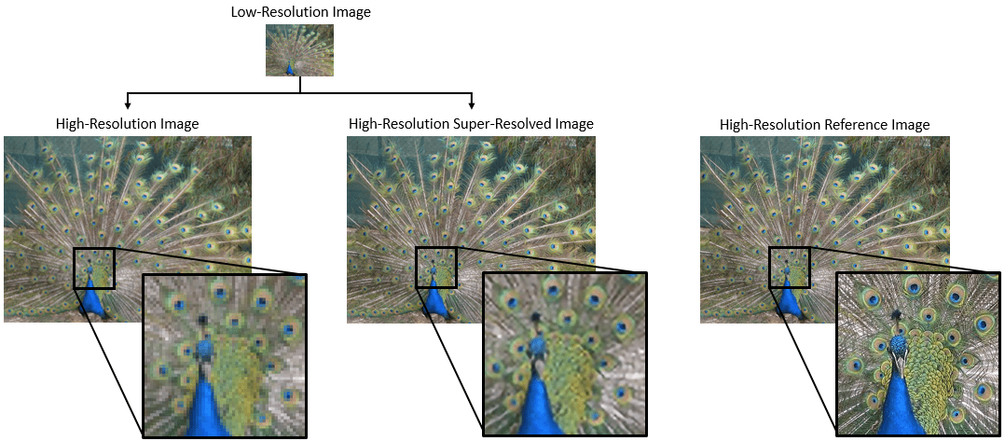
RESULT AND DISCUSSION

Slide 14
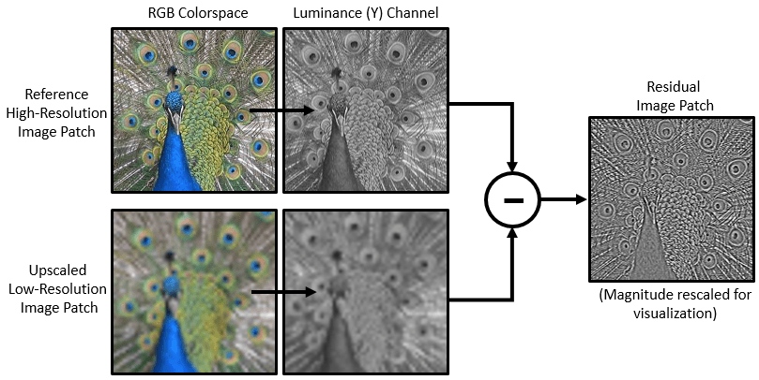
IMPLEMENTATION

Slide 15
